Slide 1
ORAL HISTORY MADE EASY
WEEK 1: Deciding what sort of an oral historian you want to be
Sunday 9th March 2025 14.00 hrs GMT
With DR ANGELA MAYE-Banbury BA MSc PhD SFHEA
ORAL HISTORIAN & EMERITUS FELLOW IN ORAL HISTORY

Slide 2
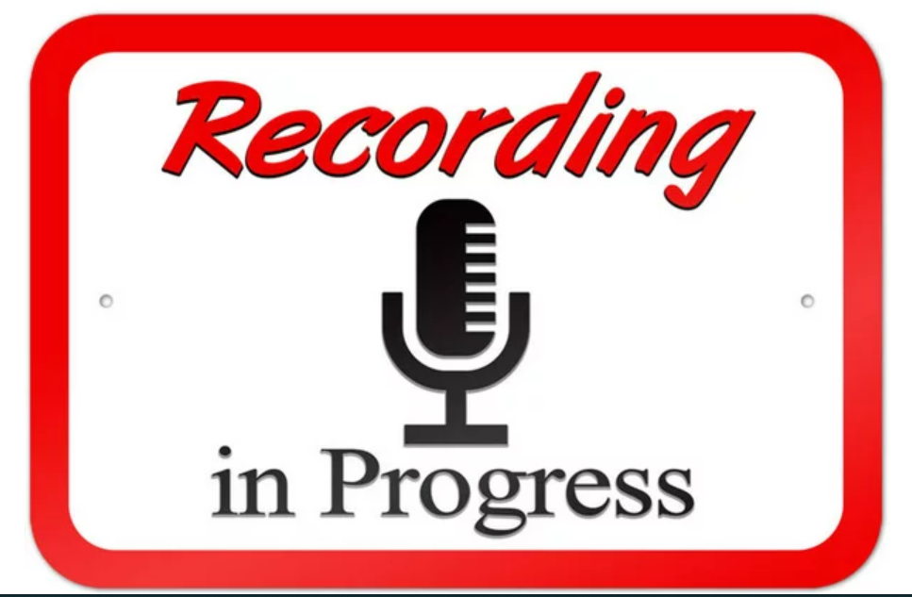

Slide 3
What we will have achieved at the end of today
Introductions and welcome
Explore the power of stories, why we need to preserve oral histories now and listening to the voice.
How we conceptualise oral history alongside other ways of recounting life experiences.
Your positionality as an oral historian: importance of beliefs and values on your practice as ‘habitus...’
Sharing our hopes and fears thinking about the weeks ahead.
The power of experiential learning and reflective practice.
Tour of your virtual learning environment.

Slide 4
Introductions and welcome

Slide 6
Our class covenant

Slide 7
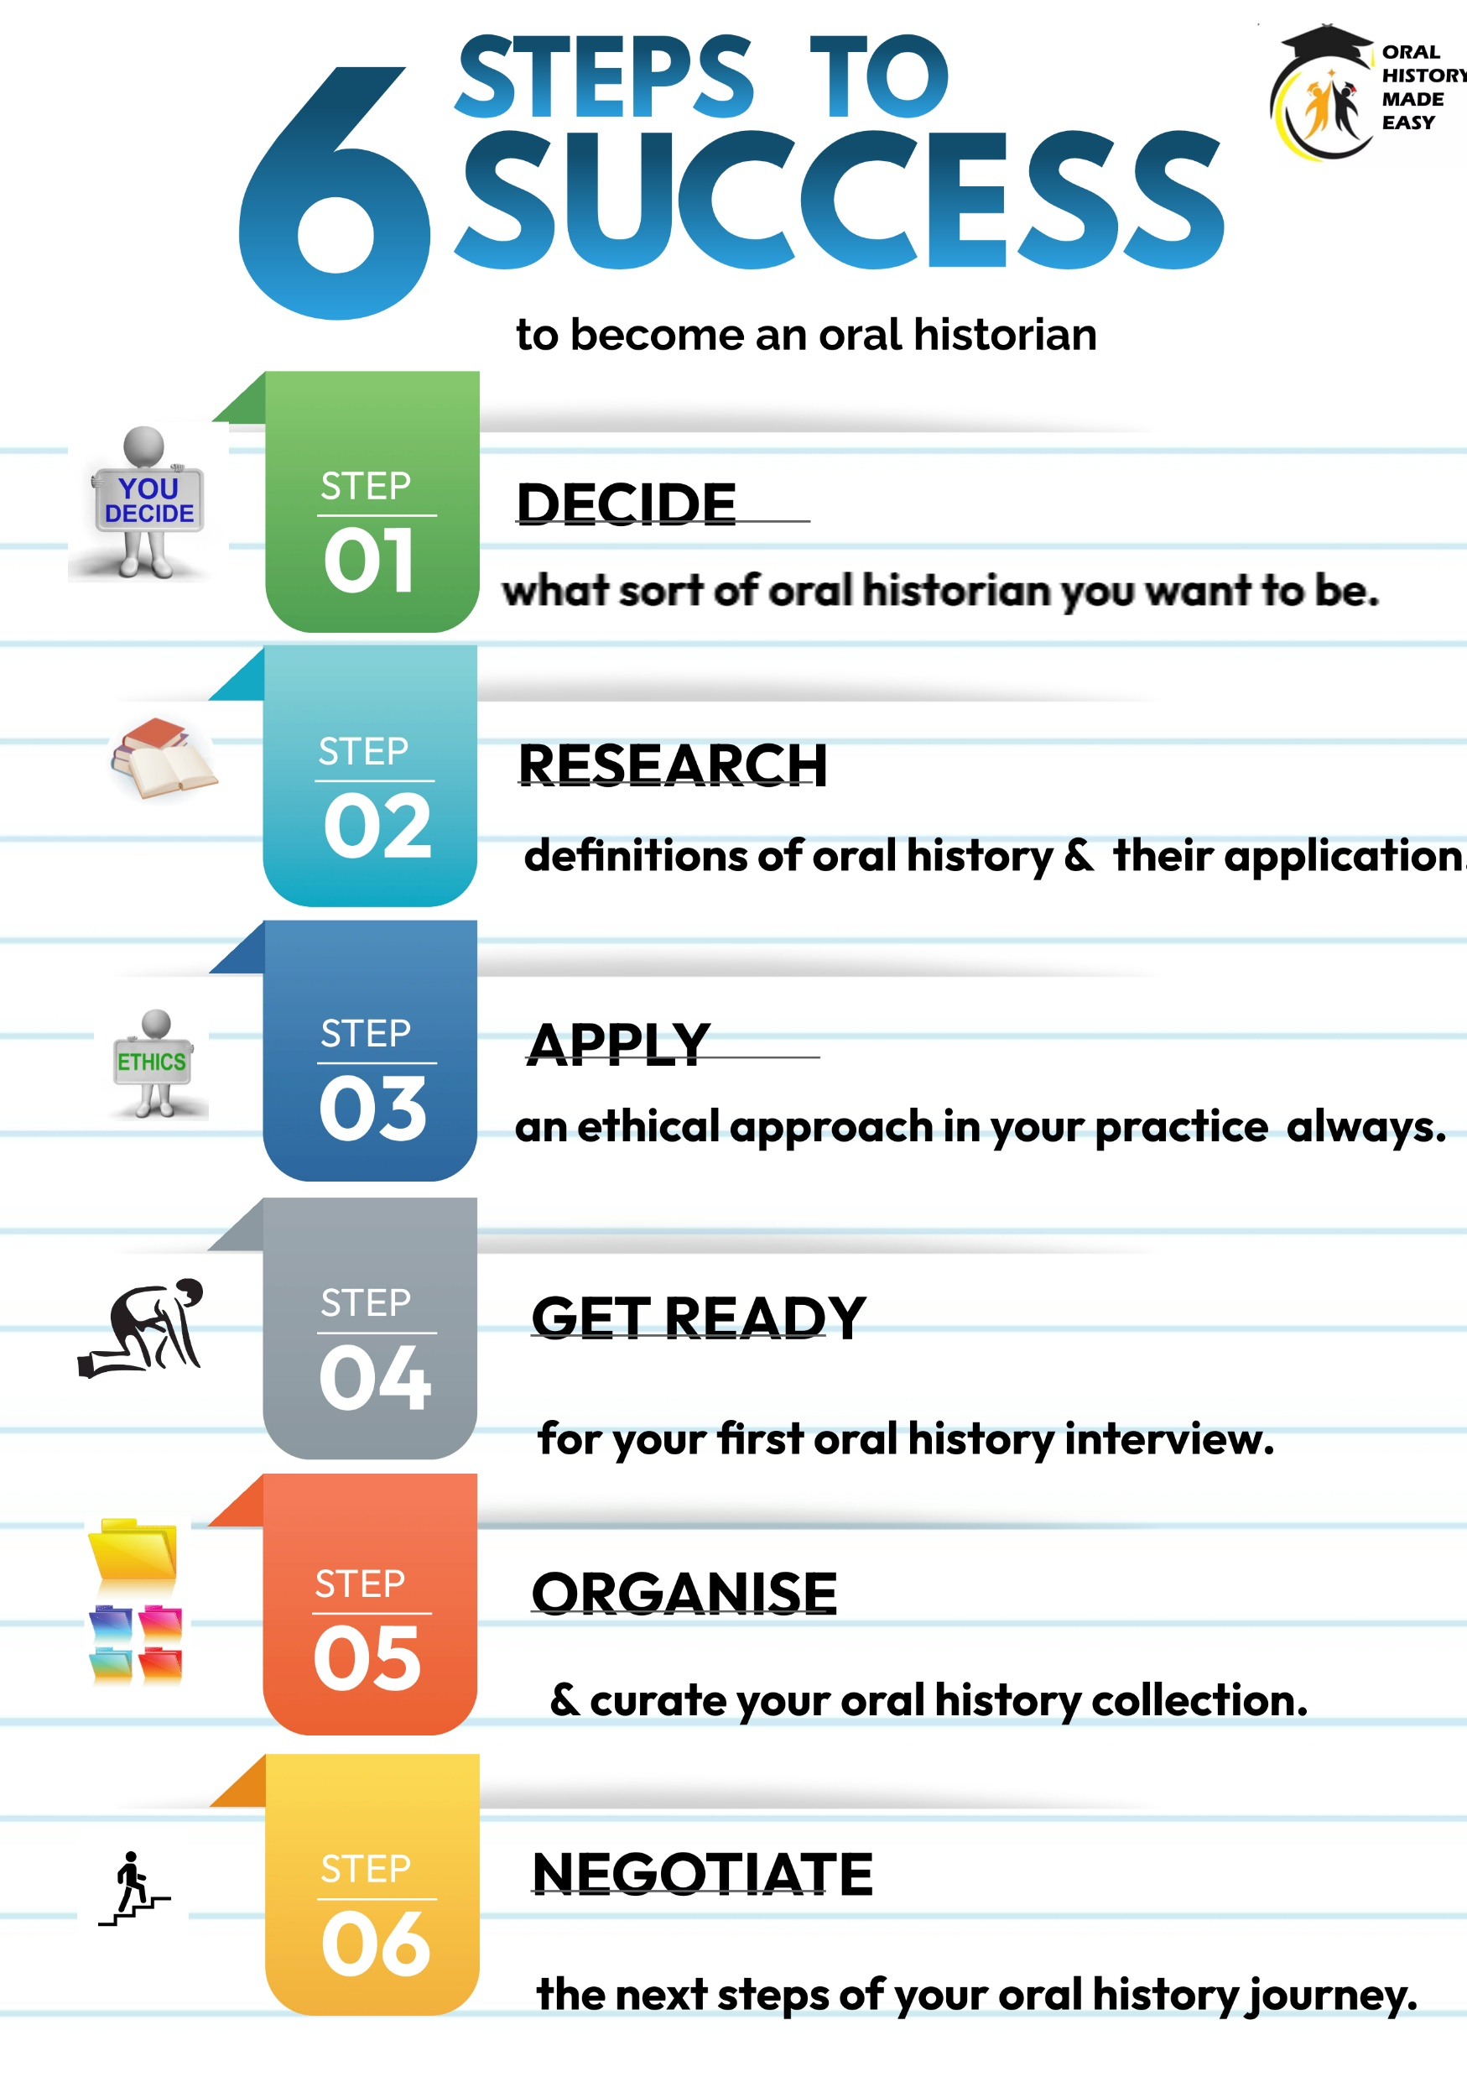
Proprietary
DRAGON FRAMEWORK
Completion of training needs analysis
1:1 Mentorship with AMB 30 mins x 2
Motivation hub meetings x 2
End point assessment (1,000 words)
Celebration event & award of certificate of participation

Slide 8
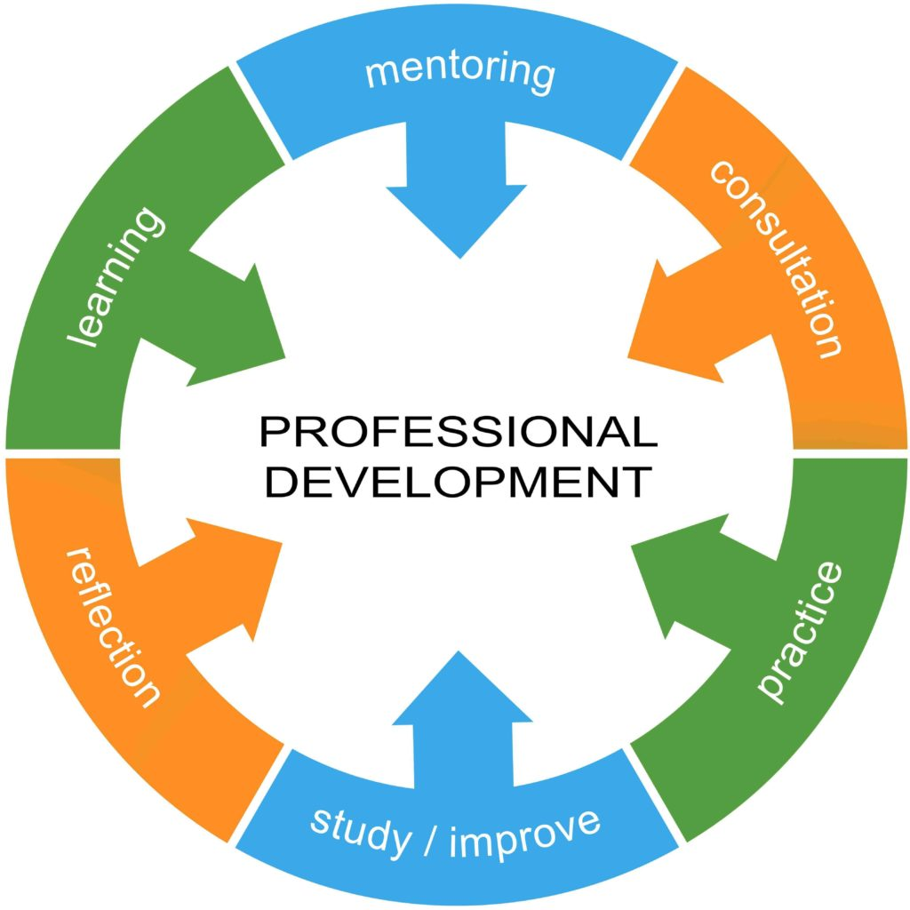
I AM AN ORAL HISTORIAN!

Slide 9
THE POWER OF STORIES

Slide 10
Oral history as ‘traces of history’ (1)
“Most human affairs happen without leaving vestiges or records of any kind behind them. The past, having happened, has perished with only occasional traces…And only a part of what was observed in the past was observed by those who observed it. Only a part of what was remembered was recorded. Only a part of what was recorded has survived. Only a part of what has survived has come to historian’s attention; only a part of what has come to their attention is credible” (Gottschalk, 1950, p 460).
“More history than ever is today being revised or invented by people who do not want the real past, but only a past that suits their purpose” (Hobsbawm, 2002: 296).
INFORMATION – MISINFORMATION – DISINFORMATION – QUEST FOR KNOWLEDGE

Slide 11
Oral history as ‘traces of history’ (2)
Infinite amount of oral history material. Yet only a small proportion of this materials end up being properly curated, analysed and disseminated in one form or another.
Lack of knowledge, skills and attributes to collate and curate oral histories.
Need to embed analysis and dissemination into your oral history project plan.

Slide 12
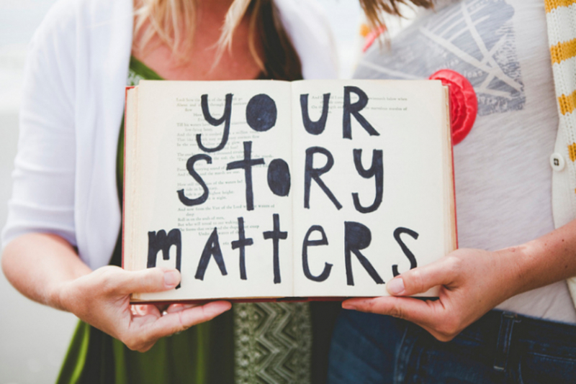
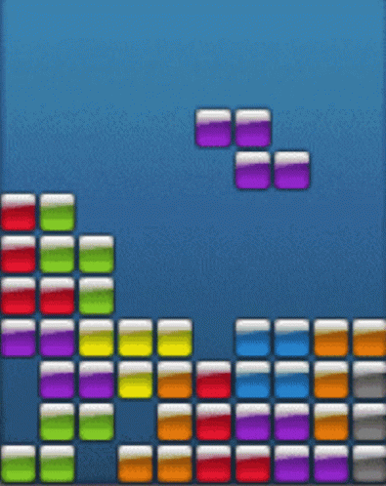
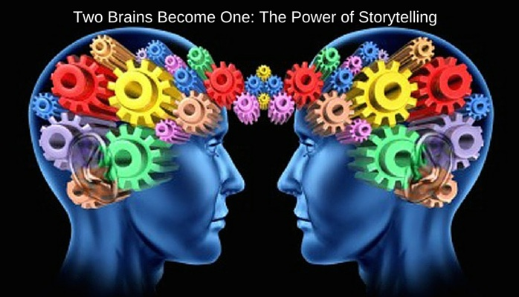
The power of stories
We are hard wired to share our stories .‘Neurons that fire together, wire together.’ When we hear a good story, whether factually based or otherwise, our brains actually light up causing the neurons to fuse together. This process is known as ‘neuron coupling.’
Stories are memorable. Who remembers Pythagoras’ theorem over the stories we were told as children or adults? Our brains crave a sense of order and an ability to assign meaning to past events.
The ‘Tetris effect’: enhances empathy, intergenerational understanding, cohesion and harmony.

Slide 13
The importance of one to one interaction for empathy building
One to one dialogue equals ‘onesness’ and ‘overlap of selves’ (Ciandini et al , 1997; Oceja, 2014).
Our ability to show empathy and change the way we act and what we believe decreases the more people are involved: ‘compassion fade’ (Butts et al, 2019).

Slide 14
We need to preserve our stories – NOW!
Estimated that ‘born digital’ information will not be accessible in 10 years time. We need to preserve personal testimonies NOW in future proof formats.
Technological and human challenges: who is in charge of preserving internet content? What sources will future generations use? What impact does subjective decision making have on what is preserved and what is lost forever?
The internet is an inherently volatile environment: unlike the preservation of oral histories, web pages are intended to be dynamic. How many web pages have you tried to access that have been unavailable?
Many examples e.g. Saving Ukrainian Cultural Heritage Online (SUCHO) when web content is an initiative involving over 1,500 international volunteers who are collaborating online to digitize and preserve Ukrainian cultural heritage.

Slide 15
The death of ‘born digital’ sources?
“It cannot be stated clearly enough that born-digital records are highly ephemeral and, like paper records, must be consciously preserved over time. Without continual stewardship, the pace of technology advancement in software and hardware can render such records inaccessible in under 8-10 years. Beyond that point, the skills required to resurrect and interpret data from obsolete hardware, operating systems and software applications approaches those of digital forensics. This is a highly specialised and expensive field. Most data may be deemed not worth the effort” (National Archives Advisory Council, 2020, p 10).

Slide 16
I want to hear your voice
The voice has much more impact on us that reading text.
Hearing someone’s voice has a profound emotional impact on us. This is because the brain first processes speech for the emotion in sounds in the amygdula. Those sounds then become the words that create a connection between speaker and listener (Brück et al 2011; Seydell-Greenwald et al 2020).
Interpersonal communication where the voice is present creates stronger social bonds than where just text (SMS; email) is used.

Slide 17
Exercise 1
Read the transcript of Tom Johnson’s interview from p 1, start of para 1 “It’s very vague really….” until p 2, end of para 1“common throughout the village.”
What impression have you formed of Tom just from reading his transcript?
Now listen to Tom’s voice Part 1 to 3 mins 05 secs
What impression do you now have of Tom having heard his voice?

Slide 18
CONCEPTUALISING ORAL HISTORY

Slide 19
Oral history in a continuum of stories
Oral history is…
Reminiscence work is…
Life story work is…
Nostalgia work is…
Personal narratives are…
Eyewitness accounts are…
Storytelling is…

Slide 20
Conceptualising oral history (1)
Oral history is the systematic recording, preservation and curation of people’s accounts of life in audio format so they may be accessible to current and future generations often as part of a public archive.
Storytelling is the interactive art of using words and actions to reveal the elements and images of a story while encouraging the listener’s imagination.
Nostalgia work is a sentimental longing or wistful affection for the past often triggering high level emotion

Slide 21
Conceptualising oral history (2)
Reminiscence work is a facilitated discussion about the past often using photos, objects and music to stimulate mental activity wellbeing.
Life story work is a way to reconnect people, often those who are vulnerable, with their past to empower them in the future.
Personal narratives are an account of past events written in the first person about a particular period or event in history.
Eyewitness accounts (or testimonies) are descriptions given by someone who was present at an event.

Slide 22
YOUR POSITIONALITY AS AN ORAL HISTORIAN: HABITUS

Slide 23
Decide what sort of an oral historian you want to be
Importance of ‘habitus’ & your ‘positionality.’

Slide 24
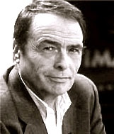
The importance of habitus in oral history
Who do we think we are? A ‘hard habitus to break’.
Habitus: socialised norms and tendencies that guide the way in which we act and behave.
Conceived by Pierre Bourdieu, French philosopher and sociologist.
1930 - 2002

Slide 25
What are the beliefs and values which have drawn you to oral history?
The life experiences which have drawn me closer to oral history are…
The beliefs (our convictions drawing on learned experiences and contexts which do not need proof) which have drawn me closer to oral history are…
The values (the relative worth I attribute to something which transcends context) which have drawn me closer to oral history are…

Slide 26
YOUR HOPES AND FEARS

Slide 27
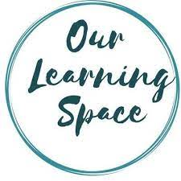
Your development journey, your way
Your past, present and future experiences

Slide 28
Hopes and fears
MY HOPES | MY FEARS

Slide 29
EXPERENTIAL LEARNING AND REFLECTIVE PRACTICE

Slide 30
Experiential learning
The power of reflective practice
Our ability to engage in deeper learning is enhanced by reflective practice

Slide 31
The Six Step Programme To Success DRAGON Framework
KNOWLEDGE, SKILLS & ATTRIBUTES
YOU NEED TO BECOME
AN ACCOMPLISHED ORAL HISTORIAN

Slide 32
1.
Promote your confidence and capability in oral history through experiential learning
2. Empowering you to practice oral history through mentorship and peer support
3.
Promoting ethical practice are present at every stage when conducting oral history
4.
Future proofing your oral histories through digitisation
5.
Optimising your oral histories through dissemination
ORAL HISTORY MADE EASY
PROGAMME PRINCIPLES 2025

Slide 33
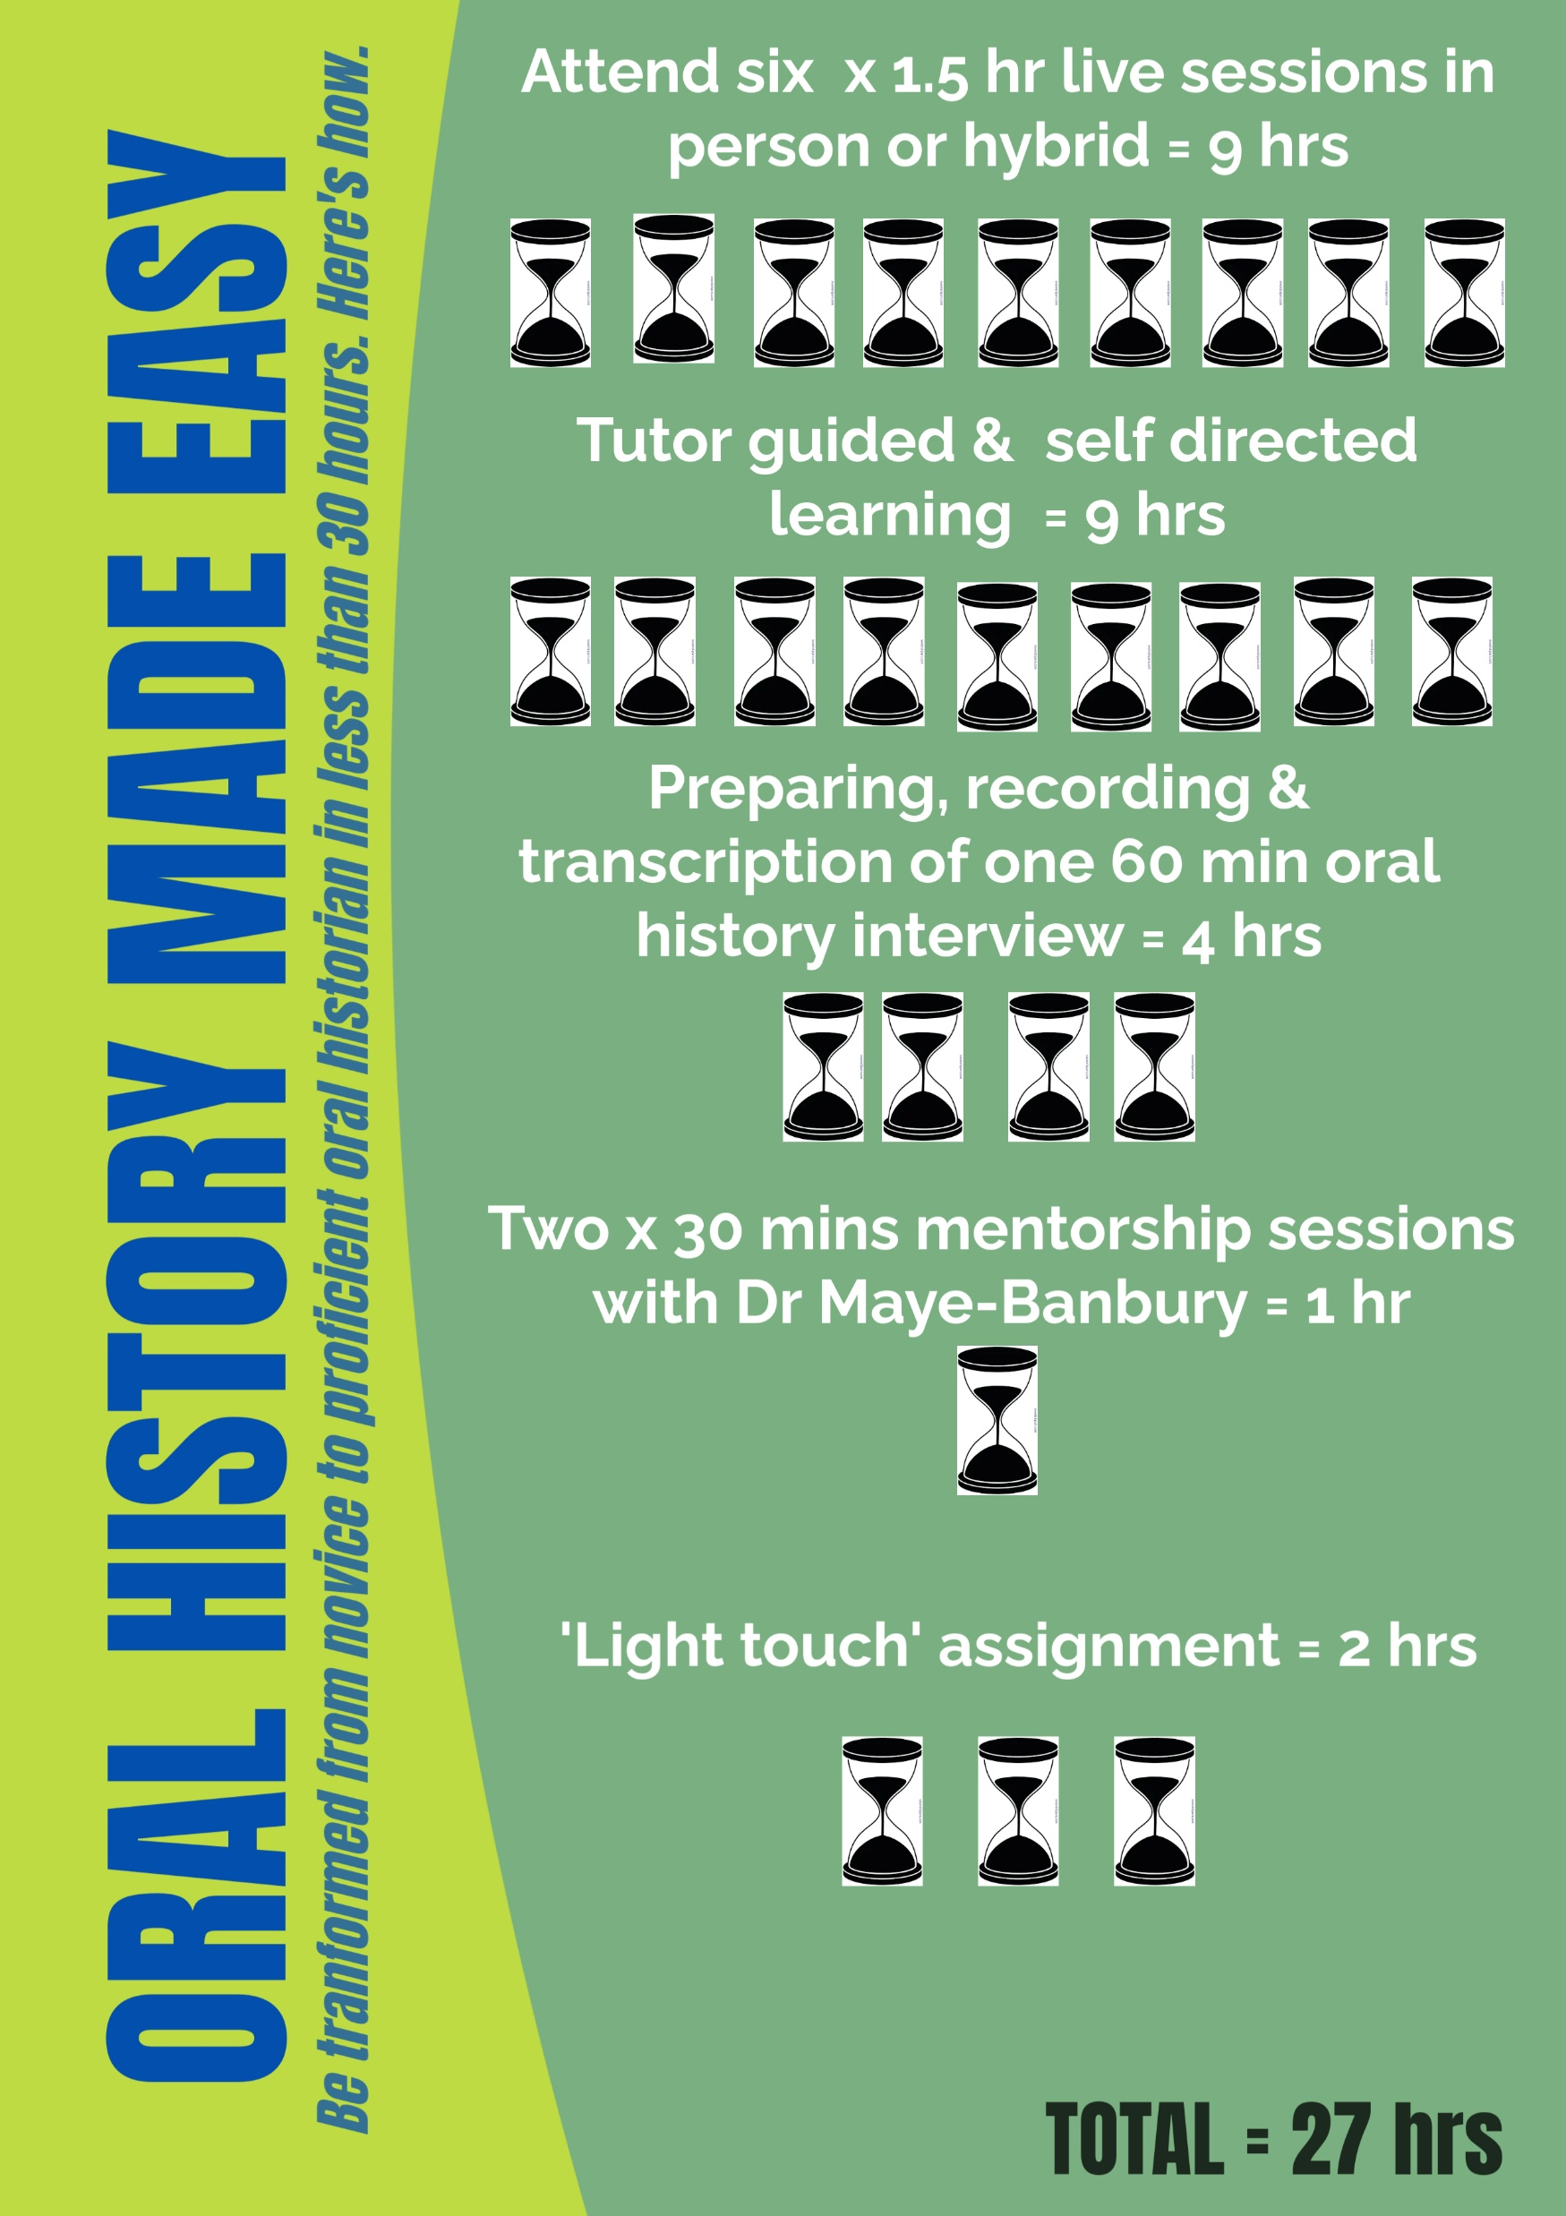
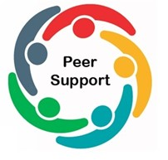
Motivation hubs: meet twice in weeks ahead

Slide 34
TOUR OF YOUR VIRTUAL LEARNING ENVIRONMENT

Slide 35
Accessing the student portal (1)
Two stage process
1.Log on the Oral History Made Easy web site and click on the ‘Student Portal Log in 2025’ in the top right hand corner. The portal is password protected. The password is Mystudentlogin1

Slide 36
Accessing the student portal (2)
Now go to the ‘Spring 2025 Cohort – click here to access all materials’ tab and use the password Oralhistorian3 to log in.

Slide 37
Week 1 folder
ESSENTIAL TARGETED LEARNING MATERIALS SPRING 2025
Zoom links for all six weeks SPRING 2025

Slide 38
Tasks for week 2
Write around 100 words between now and next week which outline your hopes and fears for the completion of the course. NB Save your reflections safely as they really useful when you write the final 1,000 word report (or equivalent) in which you will chart your progress on the course and outline a future action plan for your ongoing development.
Read Linda Shopes’ article ‘Making sense of oral history’ in week 1 resources. What is the value of oral history, according to the author?

Slide 39
What we have covered today
Explore the power of stories, why we need to preserve oral histories now and listening to the voice..
How we conceptualise oral history alongside other ways of recounting life experiences.
Your positionality as an oral historian: importance of beliefs and values on your practice as ‘habitus.’
Sharing our hopes and fears thinking about the weeks ahead.
The power of experiential learning and reflective practice
Tour of your virtual learning environment

Slide 40
References
Gottschalk, L. (1950). Understanding history: A primer of historical method. Knopf.
National Archives Advisory Council (2020) Annual Report 2020, National Archives Advisory Council: Dublin.
Sharpless, R. (2008). ‘The History of Oral History’. In Thinking about Oral History. Theories and Applications. Thomas L. Charlton, Lois E. Myers, Rebecca Sharpless (eds) Baylor University, 7-32.
Shopes, L. (2011). Oral history. The SAGE Handbook Of Qualitative Research, 451-465.

